Slide 1
CENTRO COLORRECTAL PARA NIÑOS
Maria Zornoza, MD
Puebla, Mexico
Puebla, México marzo 2024.

Slide 2
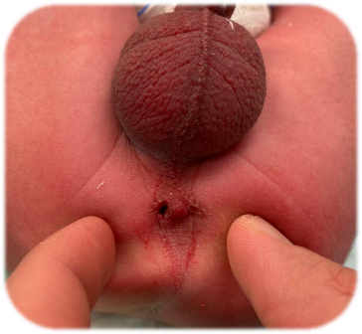
Male patient
DOB: March 15, 2020.

Slide 3
What anorectal malformation is this?
Rectoperineal fistula
Recto-bulbar fistula
Recto-prostatic fistula
Bladder neck fistula
No fistula
I don´t Know

Slide 5
Protocol

Slide 6
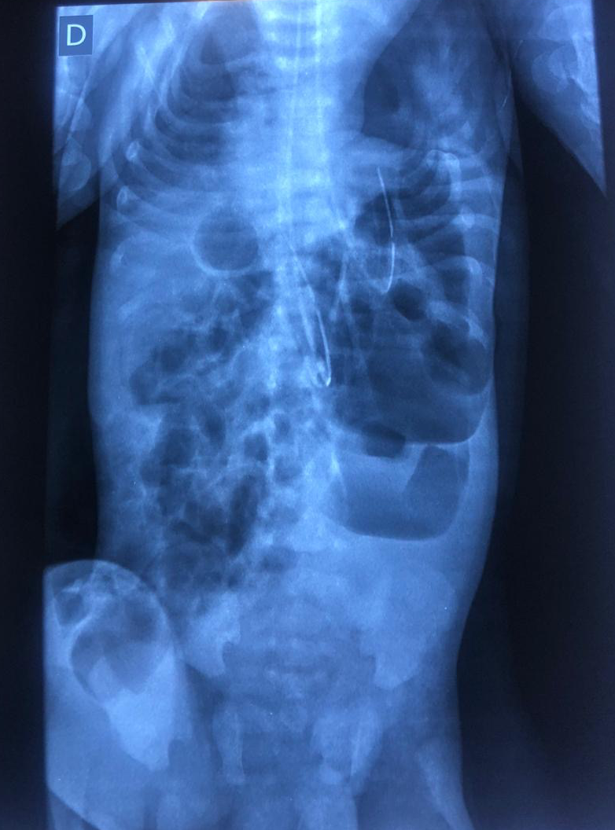

Slide 7
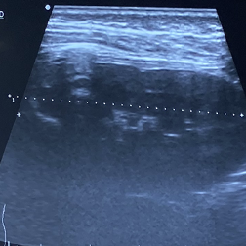
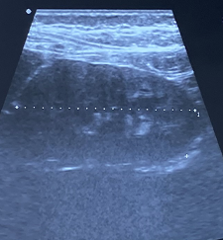
RD
RI

Slide 8
What would you do?
Primary PSARP
Colostomy

Slide 9
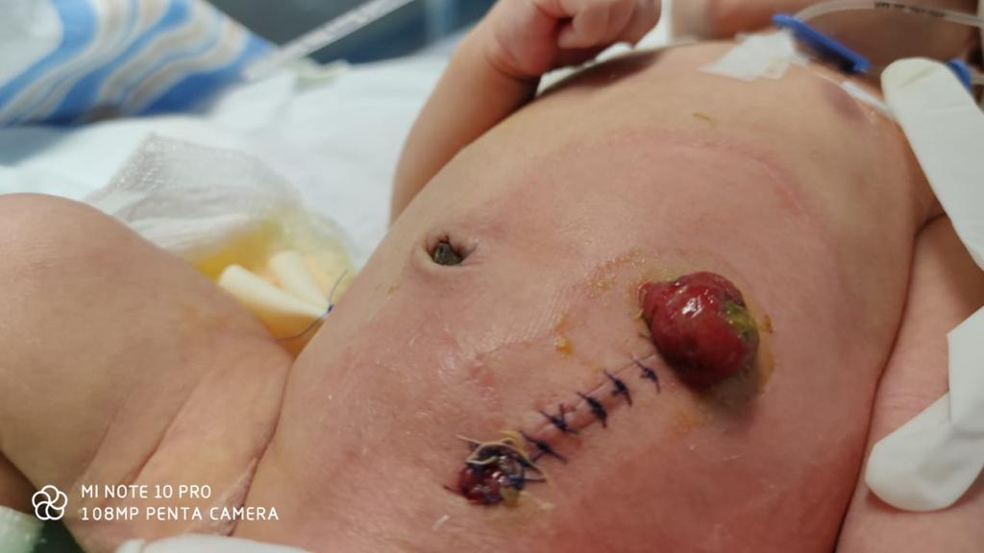
16.03.20

Slide 10
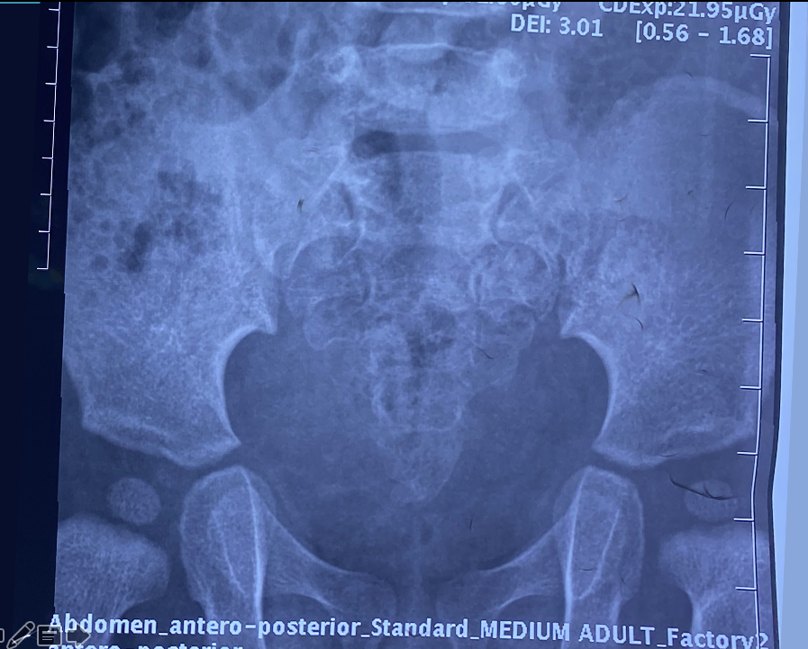
3,3
SR: 0,63
2,1

Slide 11
13.07.21

Slide 12
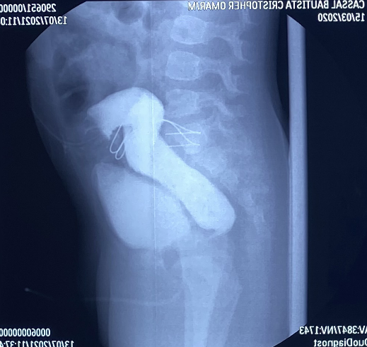

Slide 13
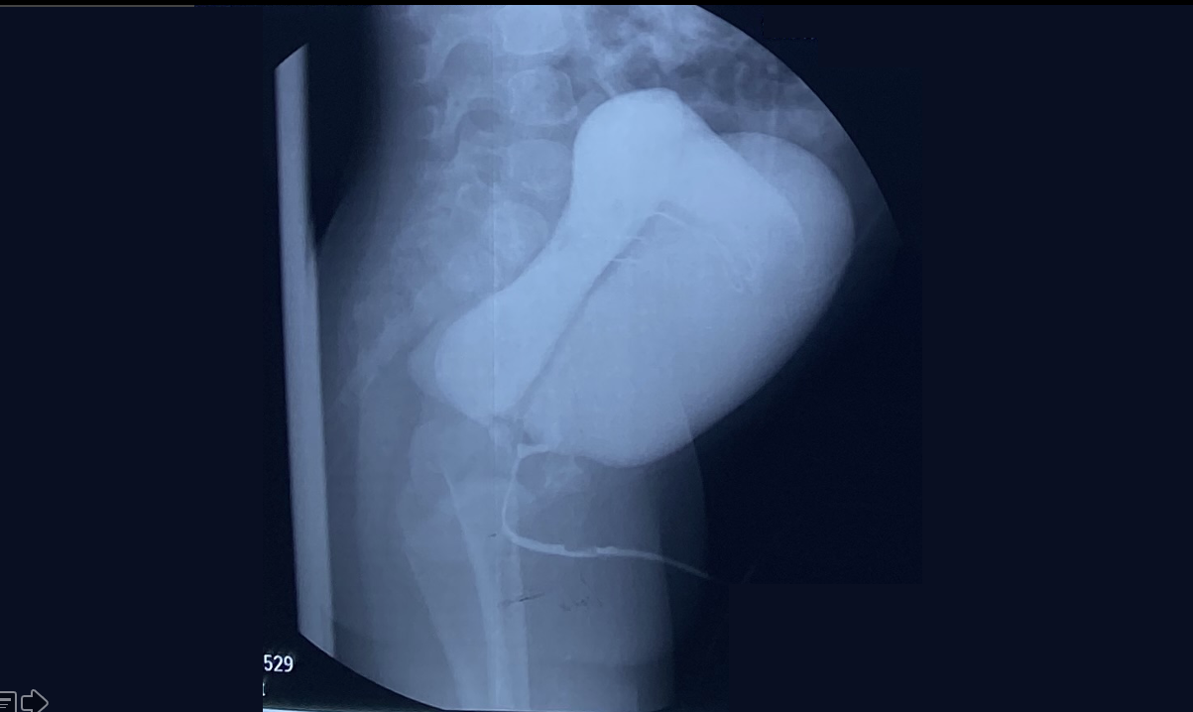

Slide 14
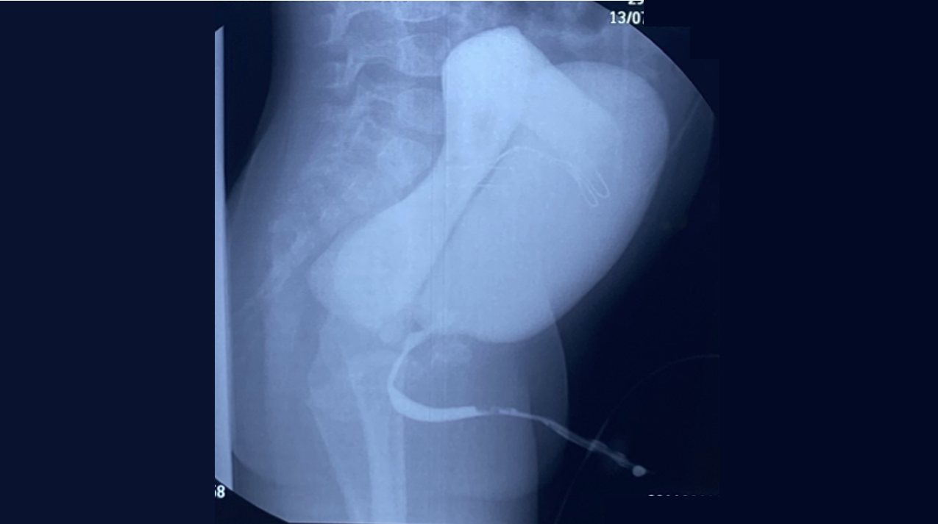

Slide 15
What anorectal malformation do you tkink this patient has?
Rectoperineal fistula
Recto-bulbar fistula
Recto-prostatic fistula
Bladder neck fistula
No fistula
I don´t know

Slide 16
Recto-prostatic fistula

Slide 17
How do you operate on the patient?
PSARP
Laparoscopic approach
Abdominal approach
Other

Slide 18
PSARP 12.05.23

Slide 19
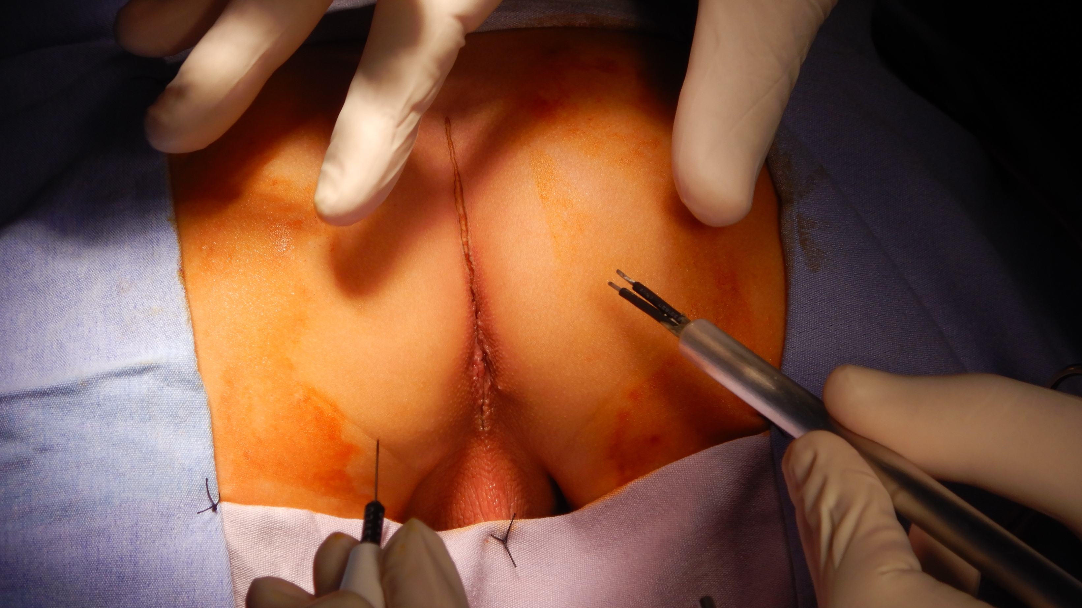

Slide 20
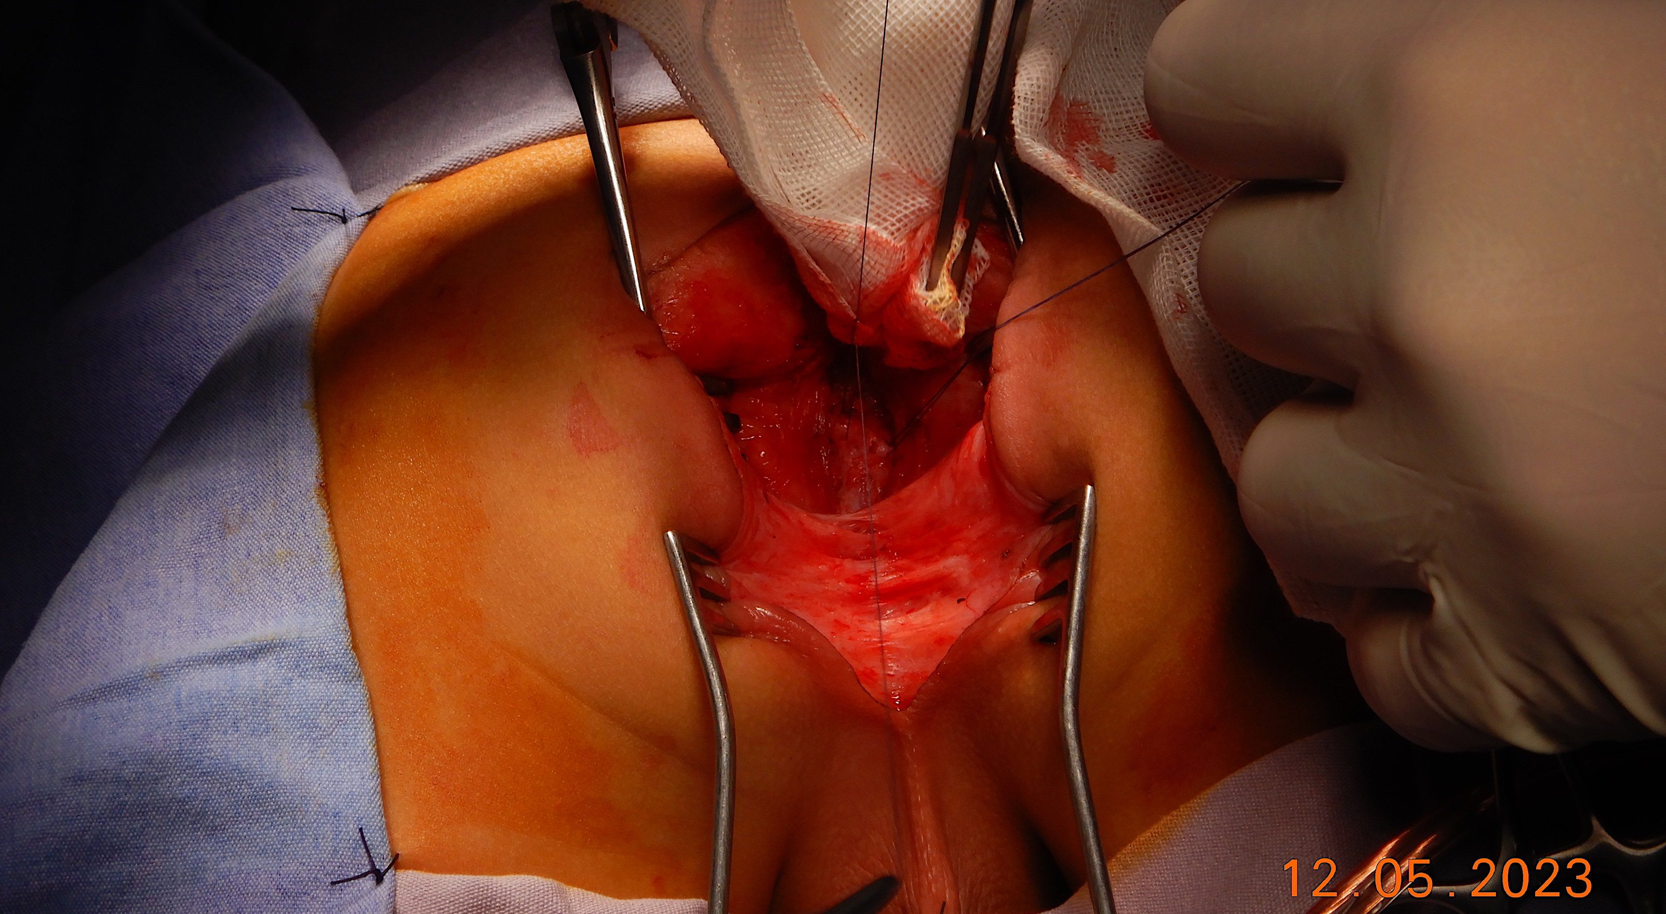

Slide 22
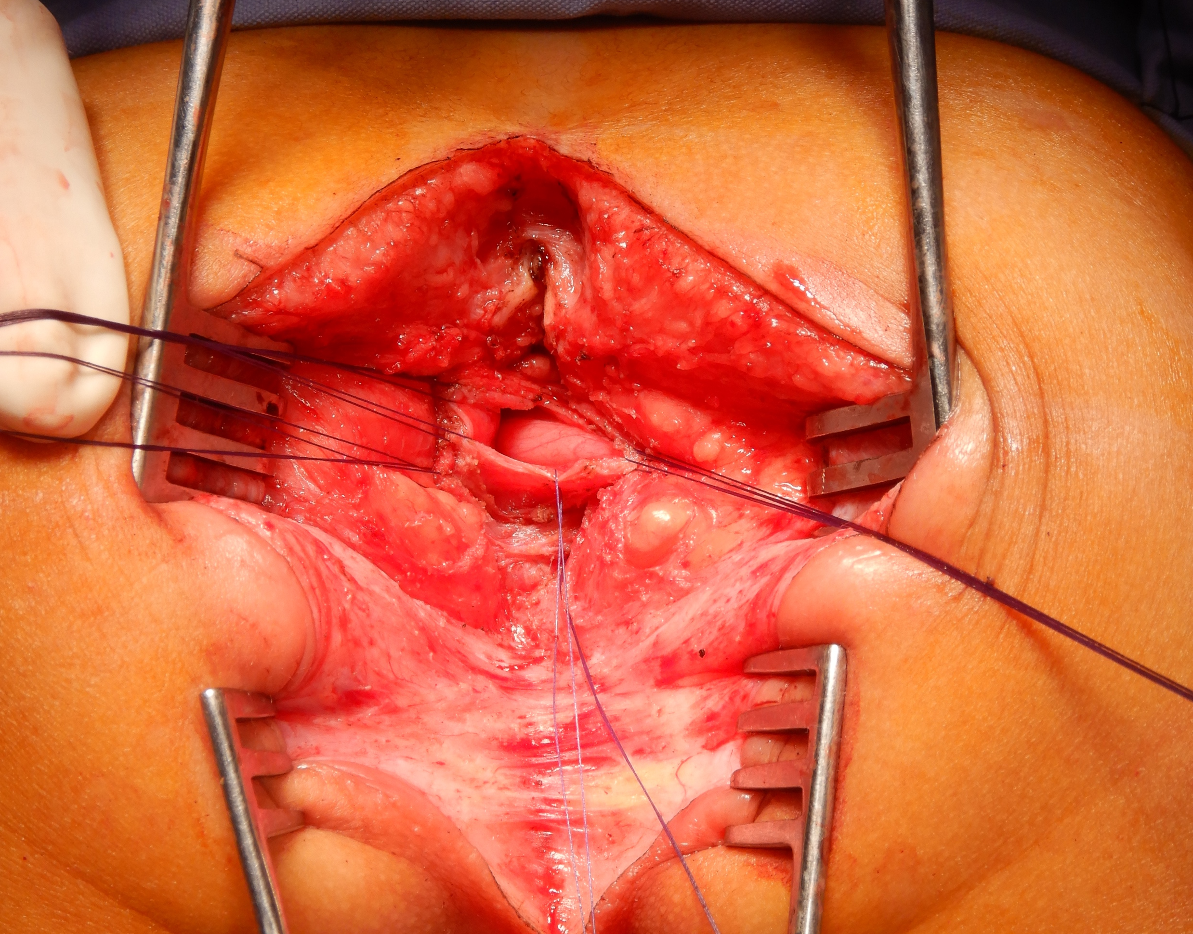

Slide 26
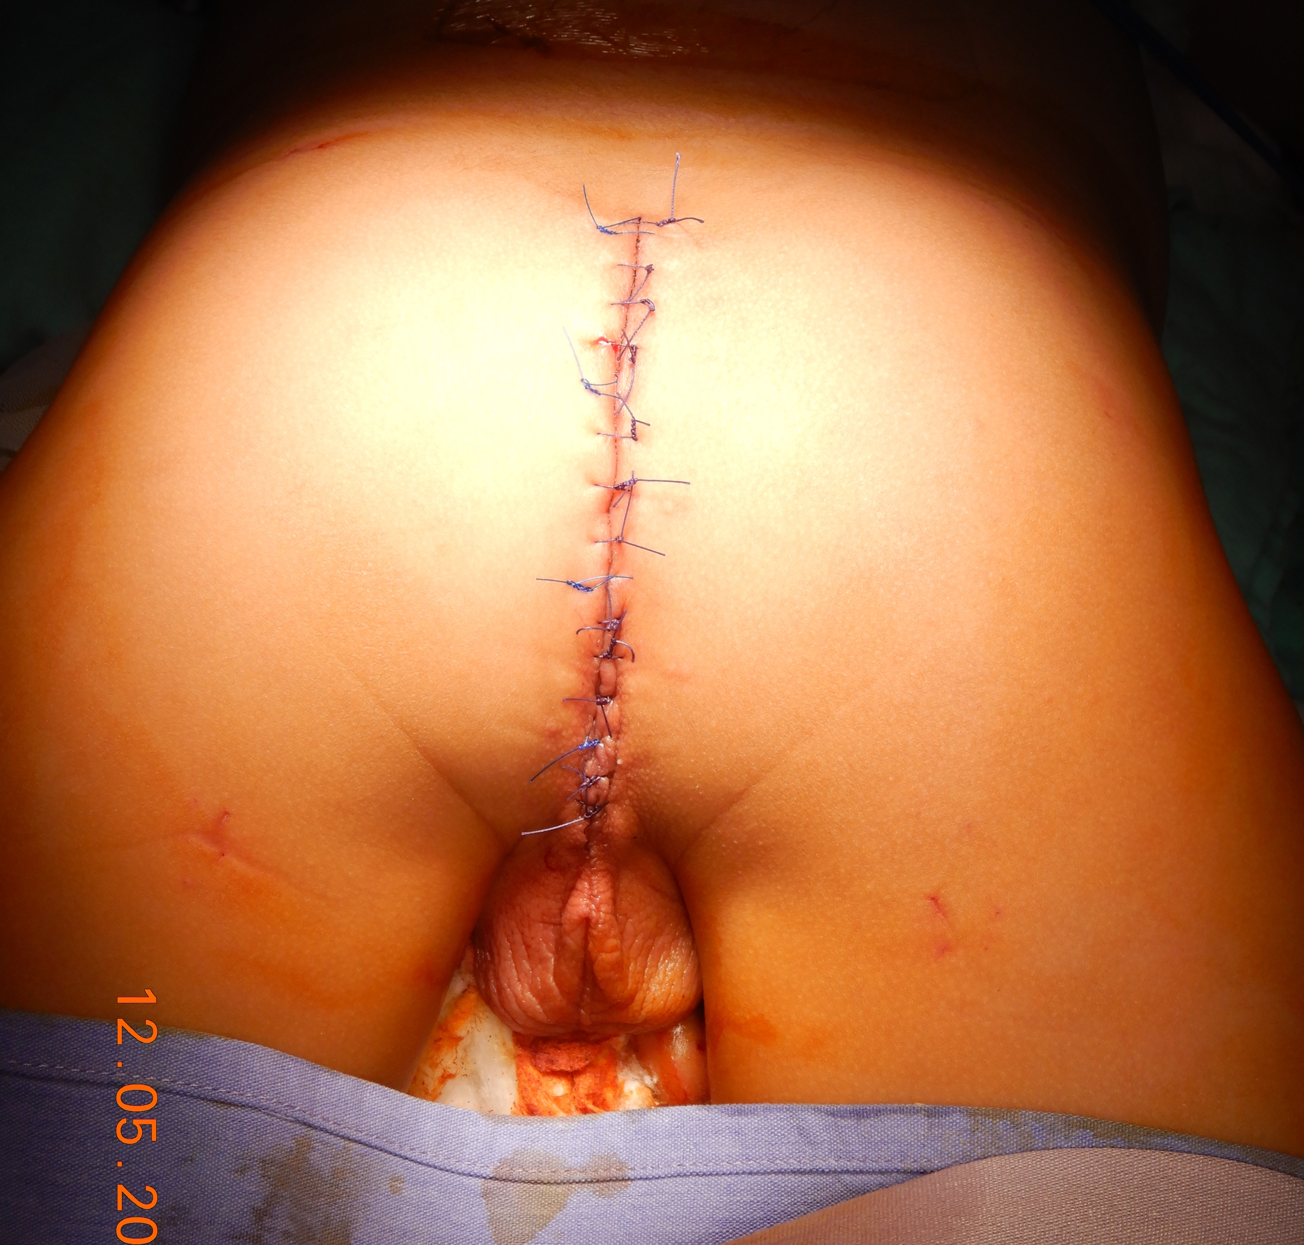

Slide 27
Three days after
Renal ultrasound, cystoscopy, and abdominal approach

Slide 28
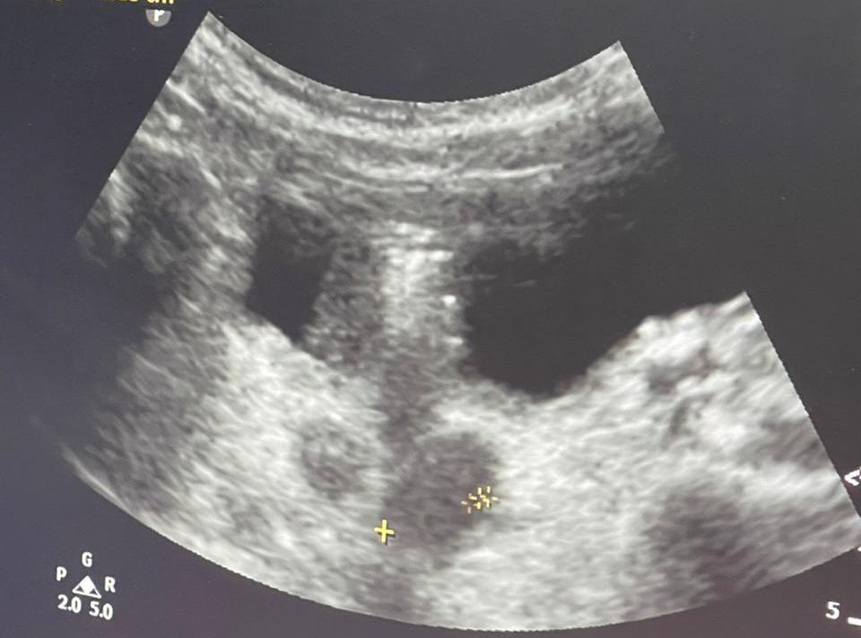
15.05.23
Left bladder diverticulum 19 x 14 mm
Left ureter inside the diverticulum
Normal kindneys

Slide 29
Cystoscopy 15.05.23

Slide 30
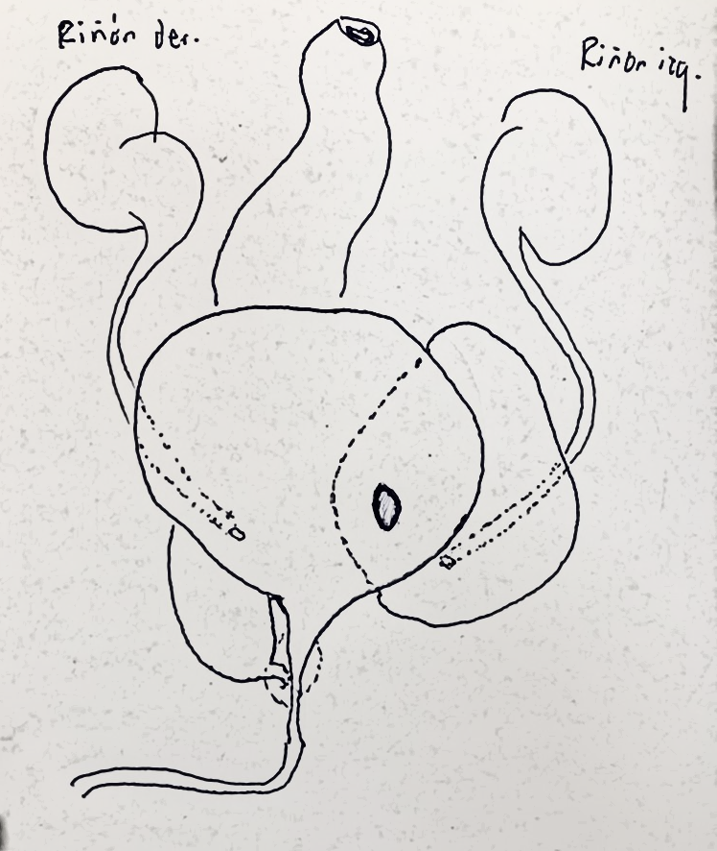

Slide 31
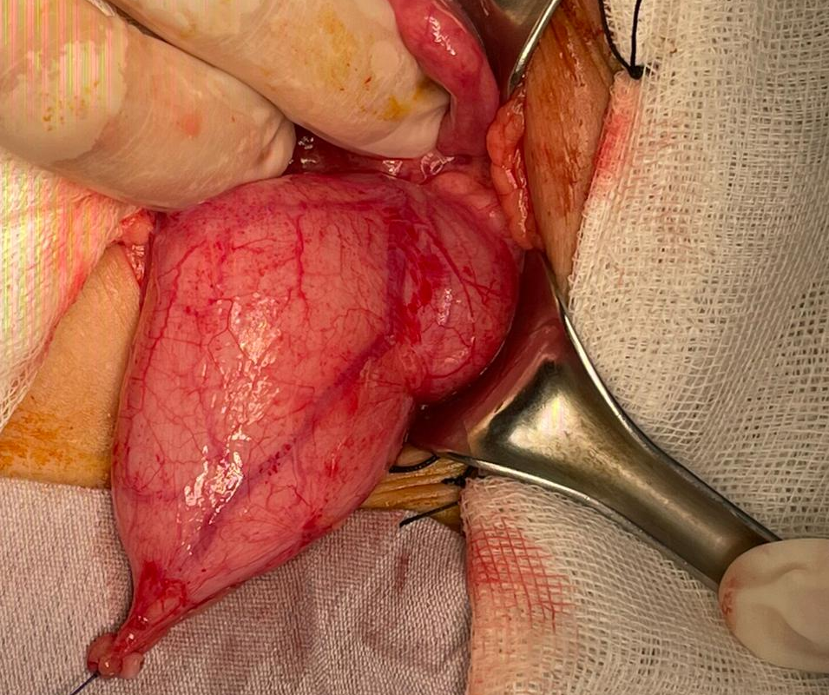
D
B

Slide 33
B
R

Slide 34
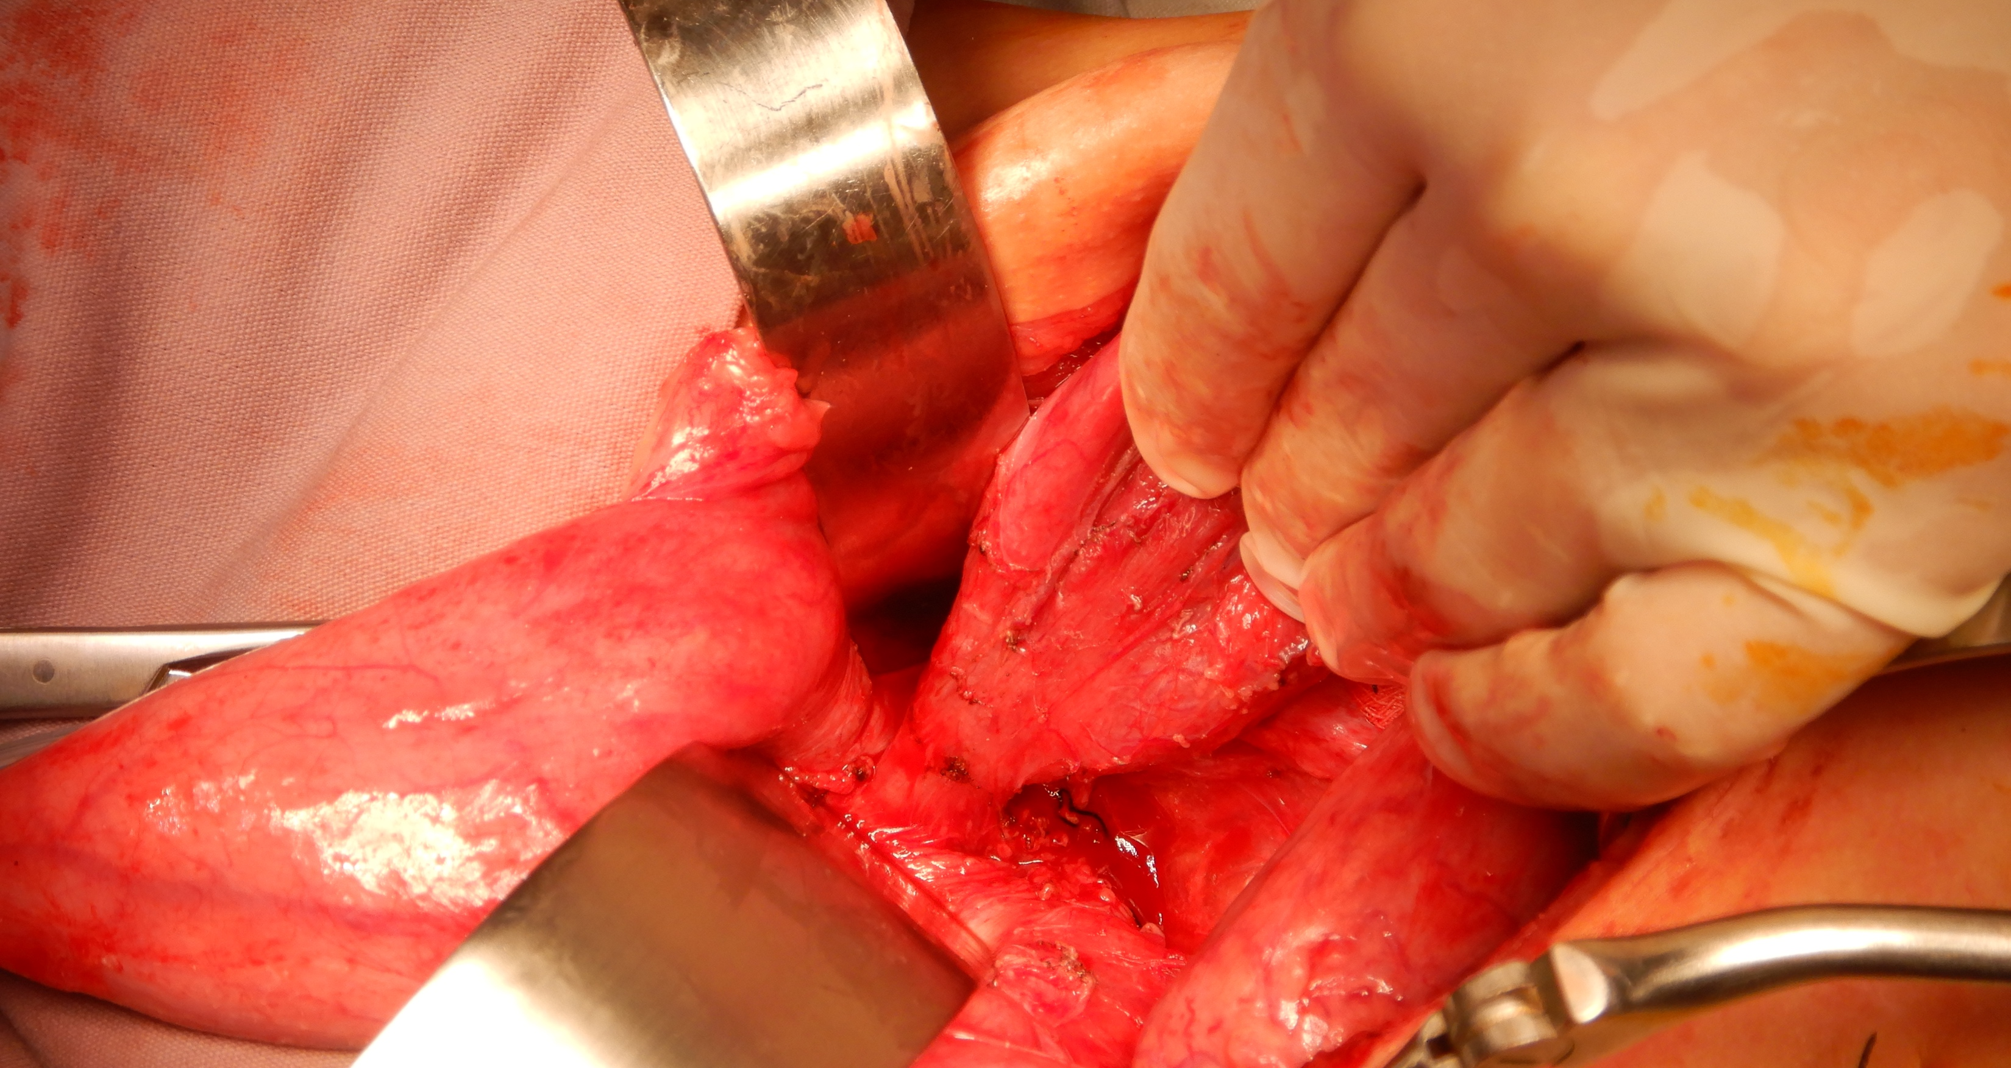
R
B

Slide 35
B
R

Slide 36
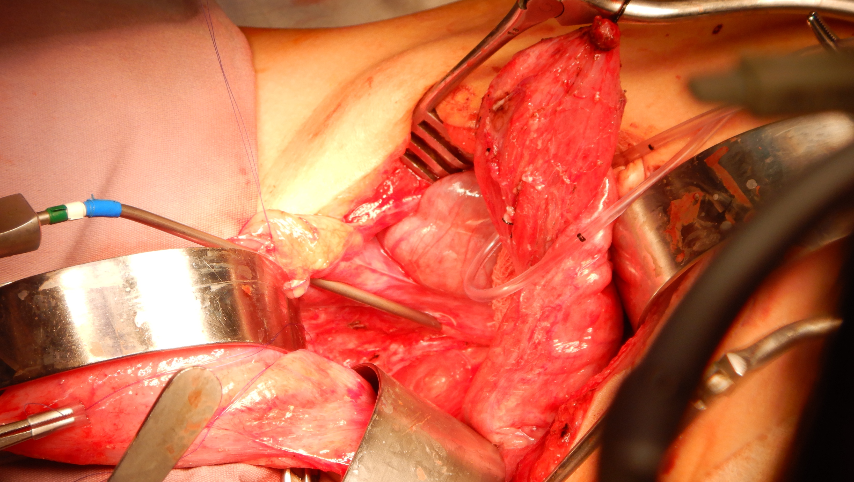
R
B

Slide 37
V
B
R

Slide 38
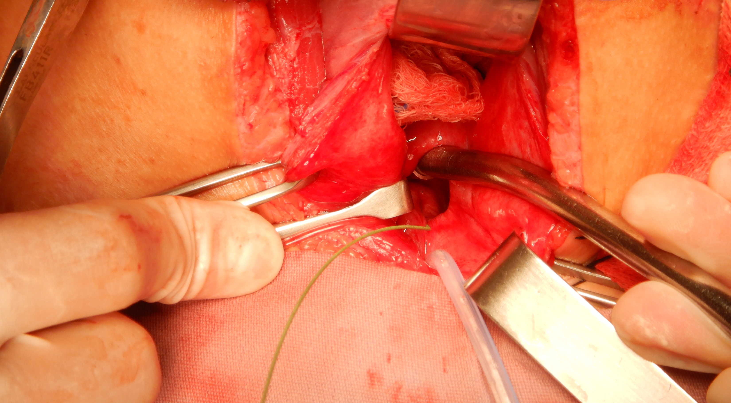
B
D
Left U

Slide 39
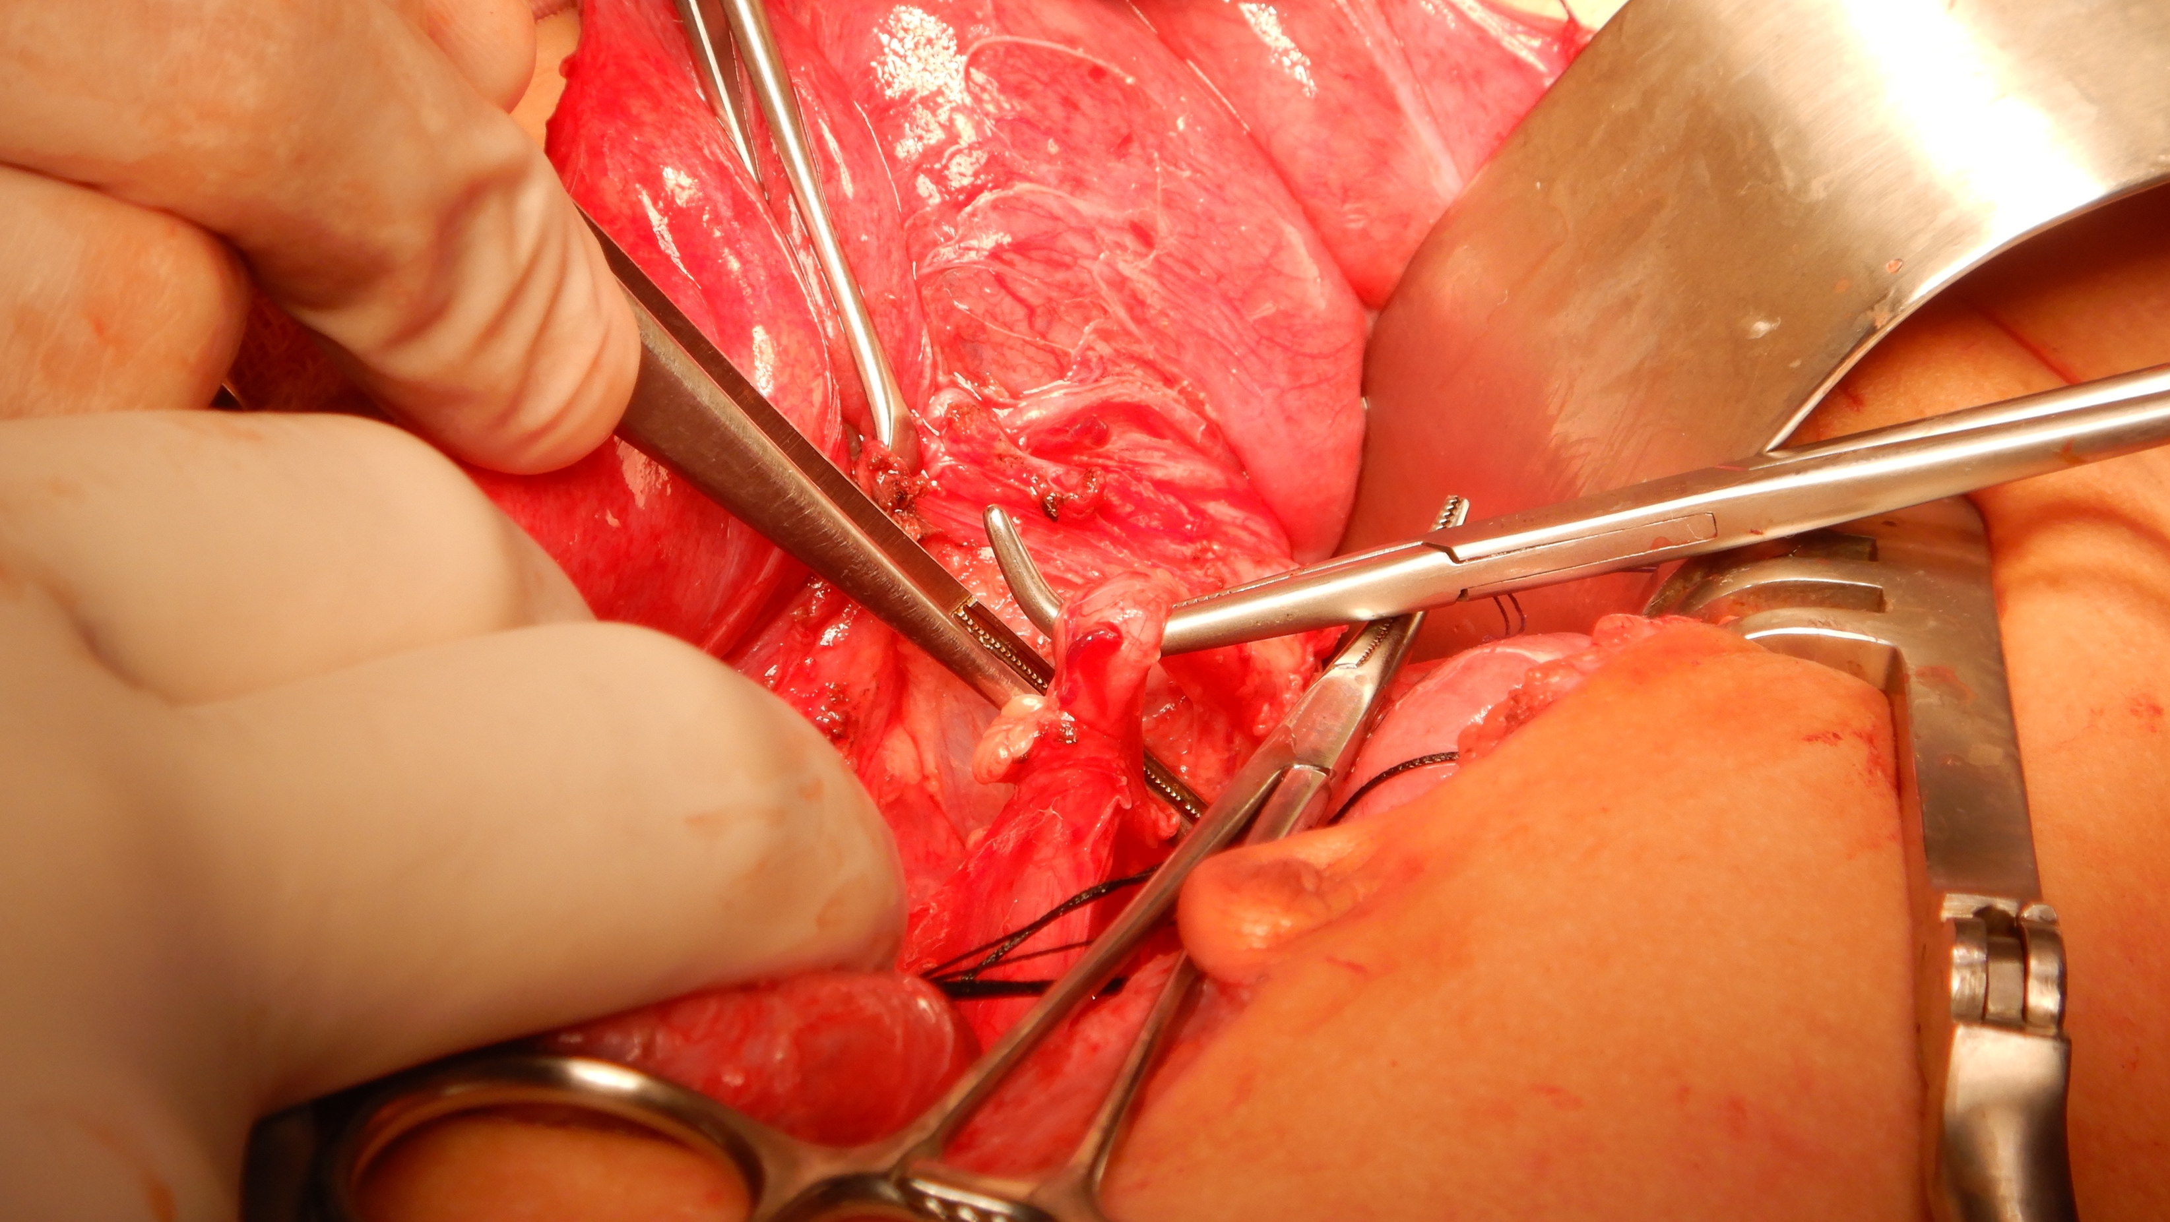

Slide 42
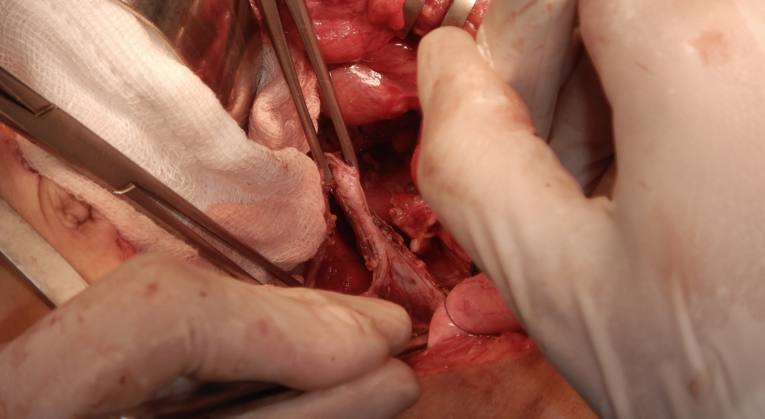

Slide 43
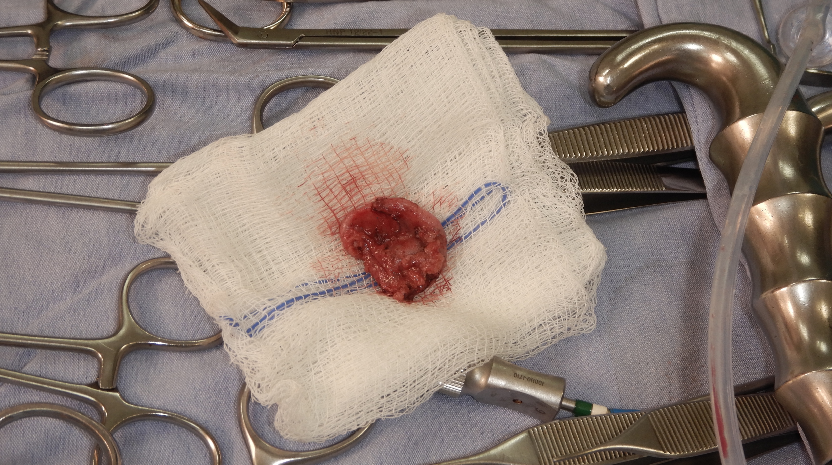

Slide 45
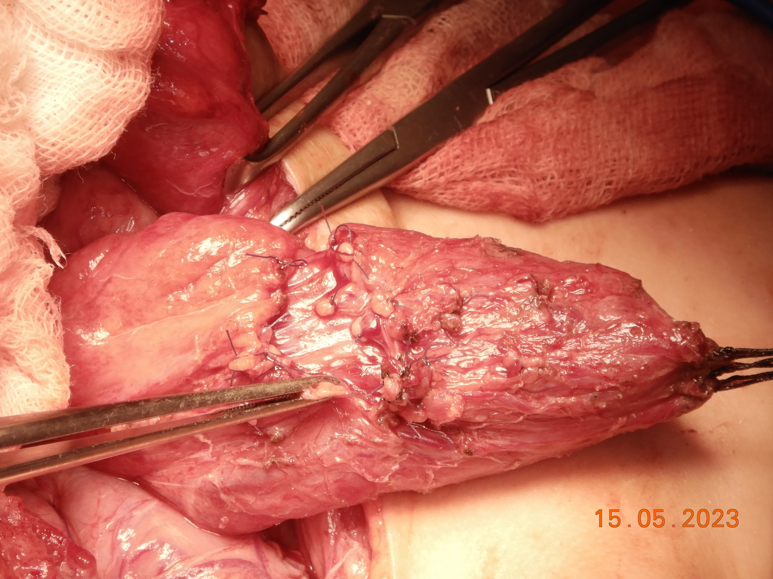

Slide 47
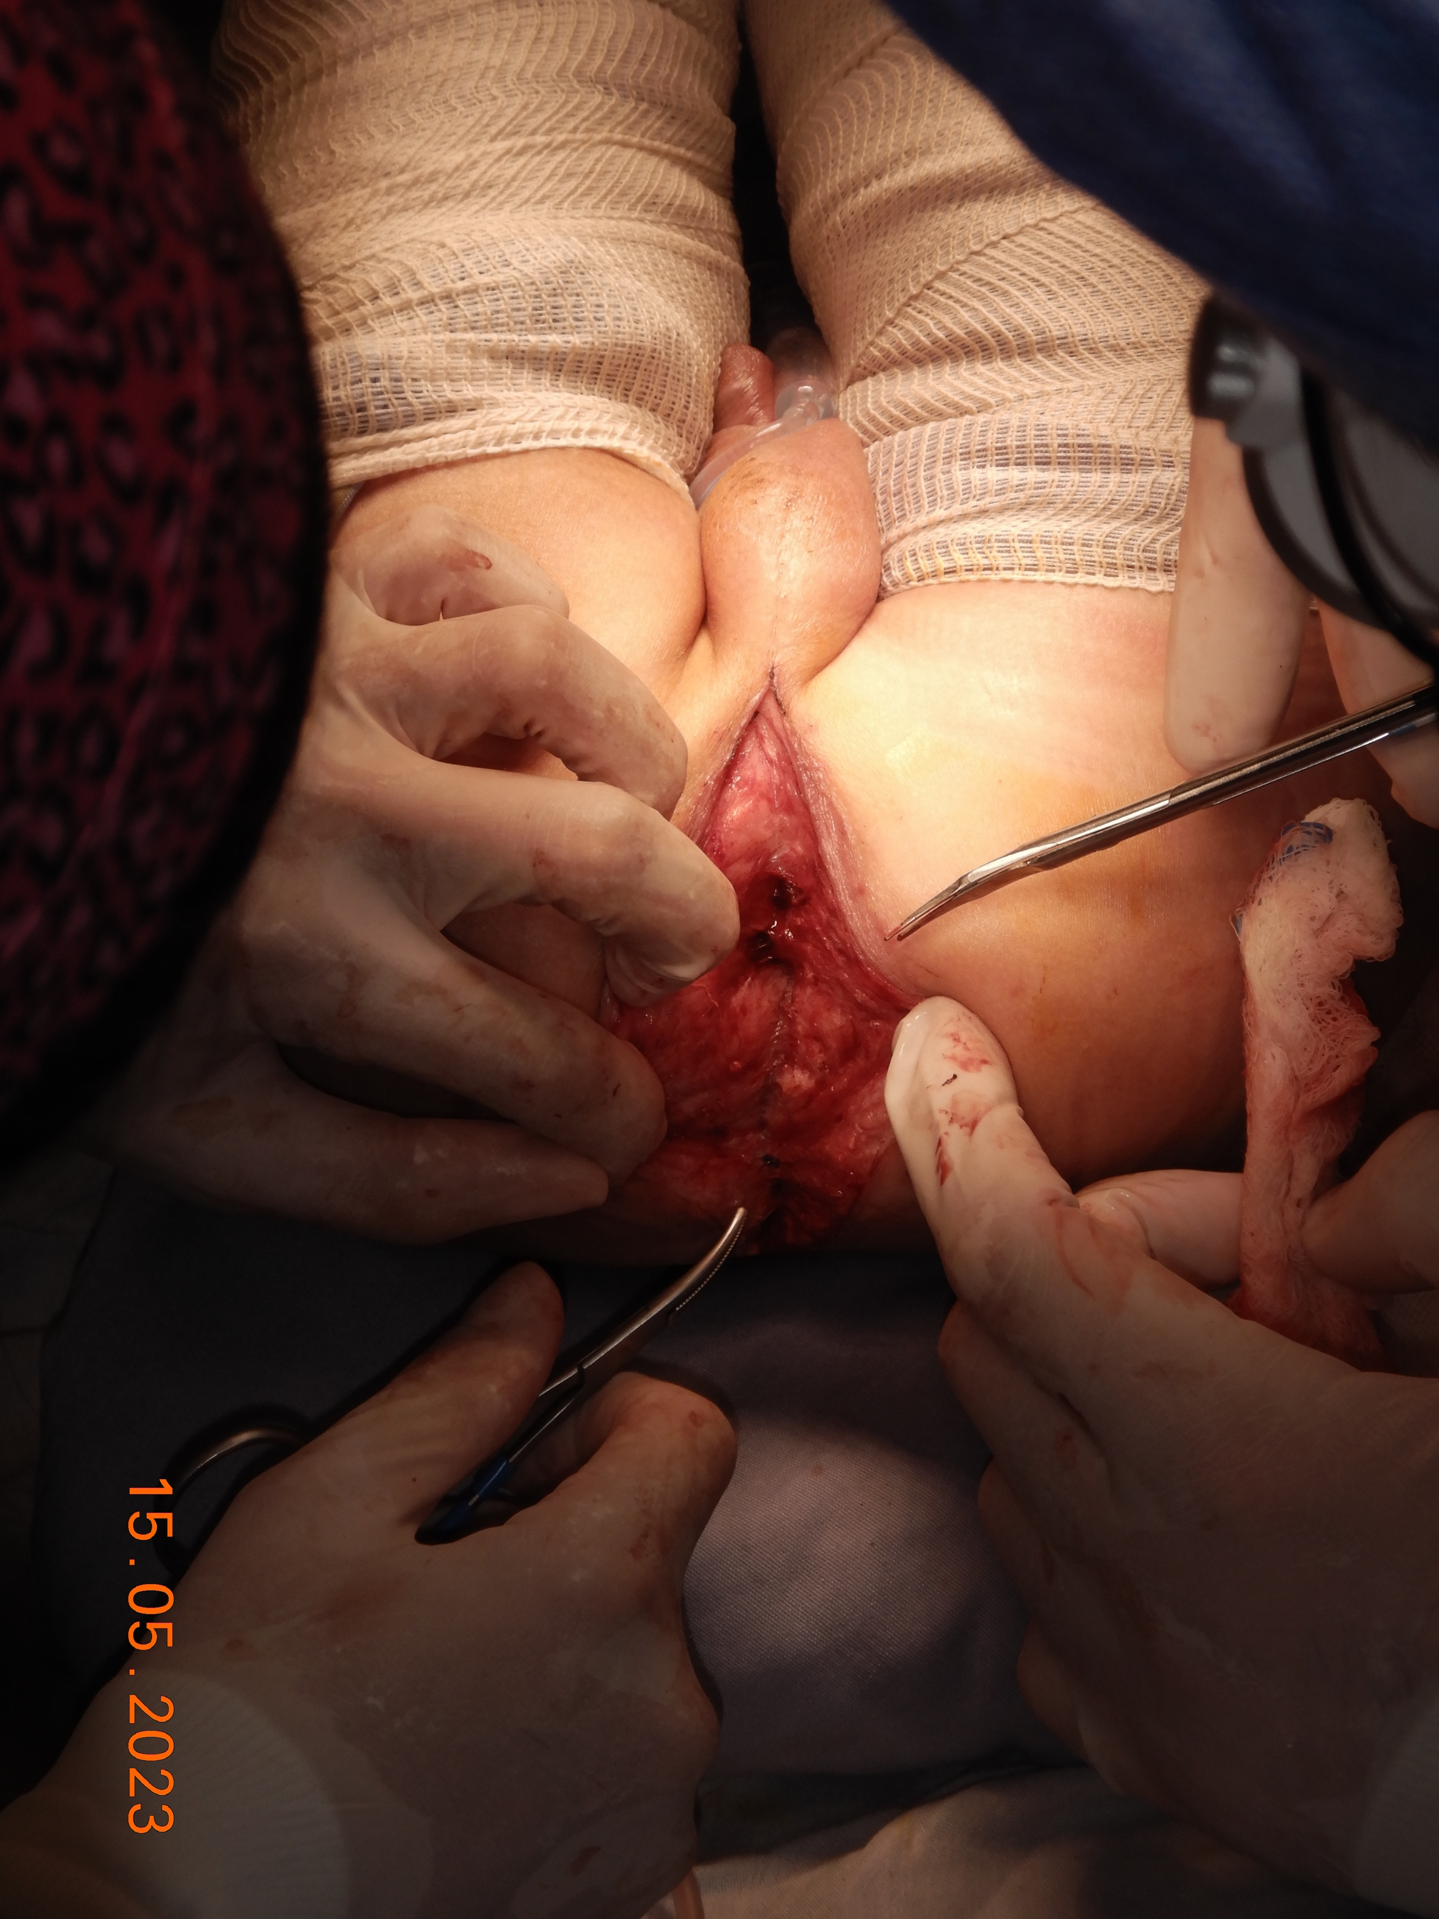

Slide 50
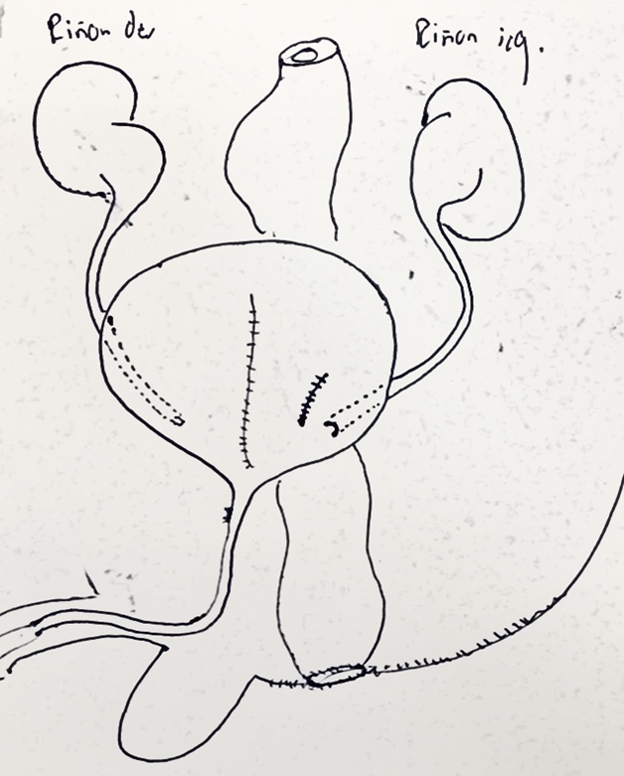

Slide 52
CENTRO COLORRECTAL PARA NIÑOS MEXICO Y LATINOAMERICA
Thank you

